Slide 1
REF2020 & Open Access : How to comply?
Dr. Nancy Pontika
Research Information Manager (Open Access)
@nancypontika

Slide 2
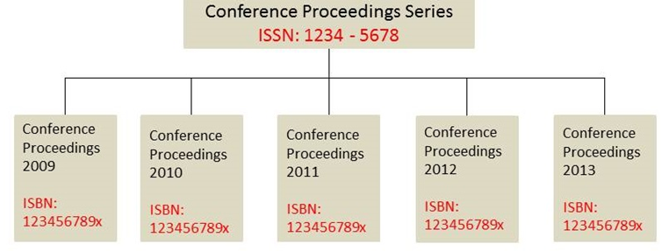
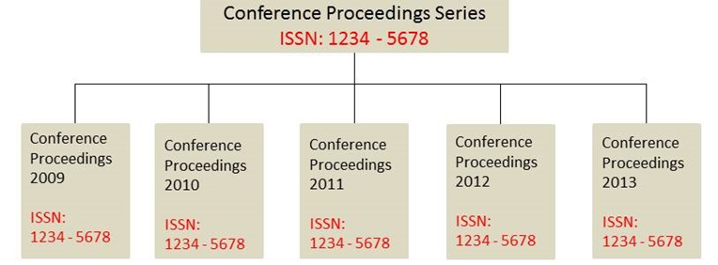
Which outputs are affected?
Journal articles & conference proceedings with an ISSN only
Outputs that do not meet this definition:
Outputs that do meet this definition:

Slide 3
REF2020 Open Access Policy : Green policy
Compliance is met via depositing (self-archiving) into a repository
No publication fee is required for the Green route to Open Access
Who should self - archive?
It is the authors of these articles who should self-archive them, in order to maximize the visibility, accessibility, uptake and impact of their work.
(Self-archiving FAQ, 2011 http://www.eprints.org/openaccess/self-faq/#self-archiving)

Slide 4
Deposits: Where, when?
Where?
Authors should deposit into Royal Holloway’s current research information management system, Pure. The College will not accept links of deposits made in subject repositories.
When?
Immediately upon acceptance for publication and no later than 3 months after the acceptance date. Outputs deposited after this deadline will not be eligible for the next REF.

Slide 5
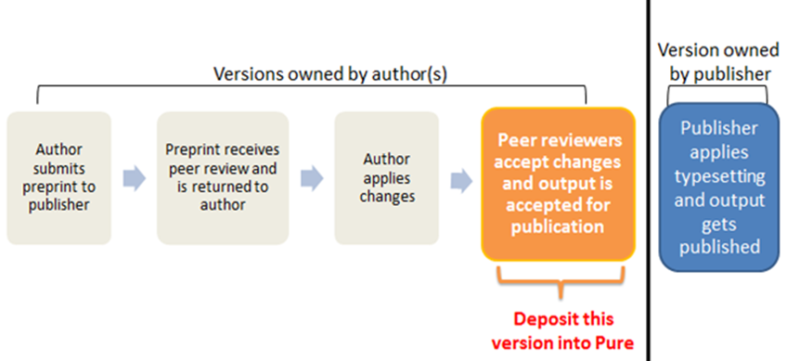
Deposits: Which version?
Author’s final peer reviewed and accepted version of the output (post-print).

Slide 6
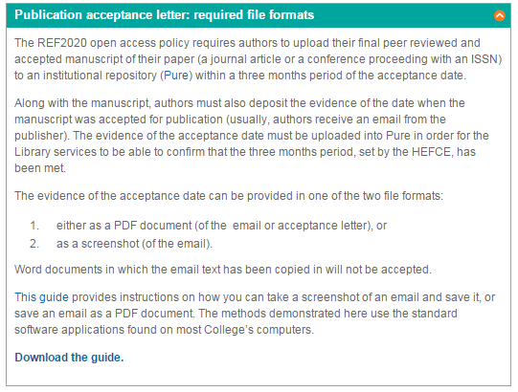
Deposits: Publisher’s email
Along with the post-print deposit you need to deposit onto Pure the publisher’s email as evidence of the date of acceptance.
https://www.royalholloway.ac.uk/library/researchsupport/openaccess/oaandref2020.aspx
Accepted file formats:
PDFs
Screenshots
Wrong file formats:
X Word documents

Slide 7
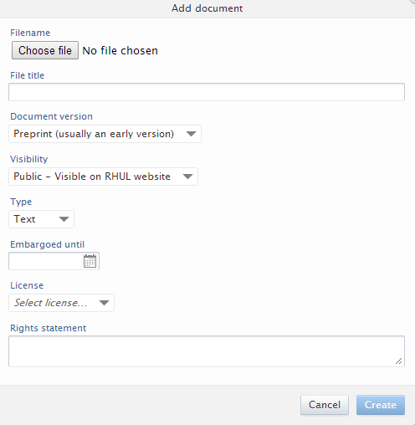
Deposits: Embargo periods
Maximum embargo periods as defined by HEFCE
REF Panels A & B | REF Panels C & D
12 months | 24 months
Authors should not set the embargo period of their outputs onto Pure, the Library is responsible for setting the embargo period.
When in Pure, in the section ‘Visibility’, select
‘Not on web – Visible to any user logged into Pure’
for all documents.

Slide 8
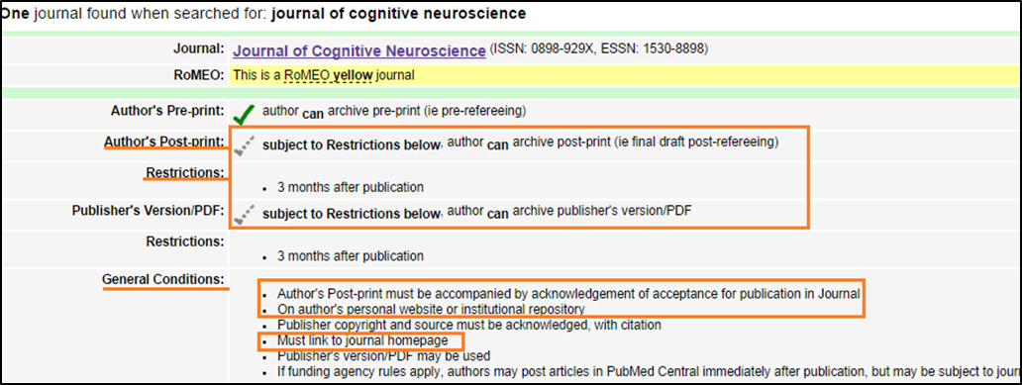
SHERPA RoMEO
An author publishing in this journal can deposit a post-print into a repository, but needs to respect the 3 months embargo period.
This means that the journal meets the REF2020 open access requirements.

Slide 9
Licenses
HEFCE wants the UK HEI outputs to be discoverable and free of cost; it advises for the use of a Creative Commons (CC) license, without expressing a preference for a specific CC license.
Royal Holloway authors must ensure that the terms of the journal or conference they plan to submit their research outputs allows self-archiving into the institutional repository, i.e. Pure.

Slide 10
Important dates
22 October 2014 – Establishment of new publishing habits
Deposit as soon as possible onto Pure all journal articles and conference proceedings that were accepted for publication after 1st January 2014, along with the publisher’s email indicating the acceptance of publication.
1st April 2015 – Internal Policy deadline
Comply with the deposit requirement only; deposit onto Pure within 3 months of acceptance for publication the post-print and publisher’s email.
1st April 2016 – HEFCE Open Access Policy implementation date
Compliance with both requirements: deposit and open access: the post-print and the publisher’s email must be deposited onto Pure within 3 months from acceptance for publication and the publisher must allow a maximum embargo period of 12 months for REF Panels A & B and 24 months for REF Panels C & D.

Slide 11
Further information
Library Research Support website:
https://www.royalholloway.ac.uk/library/researchsupport/
HEFCE & Open Access section:
https://www.royalholloway.ac.uk/library/researchsupport/openaccess/oaandref2020.aspx
Open Access FAQs:
https://www.royalholloway.ac.uk/library/researchsupport/openaccess/openaccessfaqs.aspx
Email: openaccess@royalholloway.ac.uk

Slide 12
Thank you !
Q & A

